Slide 1


Slide 2
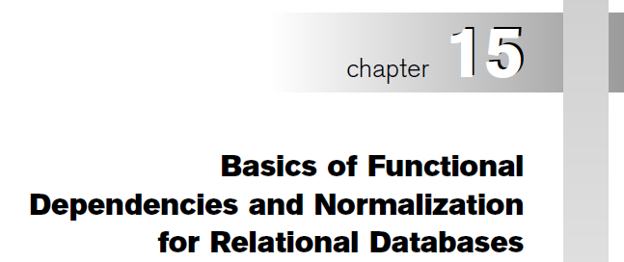

Copyright © 2004 Pearson Education, Inc.

Slide 3
Chapter Outline
1 Informal Design Guidelines for Relational Databases
1.1Semantics of the Relation Attributes
1.2 Redundant Information in Tuples and Update Anomalies
1.3 Null Values in Tuples
1.4 Spurious Tuples
2 Functional Dependencies (FDs)
2.1 Definition of FD
2.2 Inference Rules for FDs
2.3 Equivalence of Sets of FDs
2.4 Minimal Sets of FDs
Chapter 10-<number>

Slide 4
Chapter Outline(contd.)
3 Normal Forms Based on Primary Keys
3.1 Normalization of Relations
3.2 Practical Use of Normal Forms
3.3 Definitions of Keys and Attributes Participating in Keys
3.4 First Normal Form
3.5 Second Normal Form
3.6 Third Normal Form
4 General Normal Form Definitions (For Multiple Keys)
5 BCNF (Boyce-Codd Normal Form)
Chapter 10-<number>

Slide 5
1 Informal Design Guidelines for Relational Databases (1)
What is relational database design?
The grouping of attributes to form "good" relation schemas
Two levels of relation schemas
  The logical "user view" level
  The storage "base relation" level
Design is concerned mainly with base relations
What are the criteria for "good" base relations?
Chapter 10-<number>

Slide 6
Informal Design Guidelines for Relational Databases (2)
We first discuss 4 informal guidelines for good relational design
Then we discuss formal concepts of functional dependencies and normal forms
- 1NF (First Normal Form)
- 2NF (Second Normal Form)
- 3NF (Third Normal Form)
- BCNF (Boyce-Codd Normal Form)
Additional types of dependencies, further normal forms, relational design algorithms by synthesis are discussed in Chapter 16
Chapter 10-<number>

Slide 7
1.1 Semantics of the Relation Attributes
GUIDELINE 1: Informally, each tuple in a relation should represent one entity or relationship instance. (Applies to individual relations and their attributes).
Attributes of different entities (EMPLOYEEs, DEPARTMENTs, PROJECTs) should not be mixed in the same relation
Only foreign keys should be used to refer to other entities
Entity and relationship attributes should be kept apart as much as possible.
Bottom Line: Design a schema that can be explained easily relation by relation. The semantics of attributes should be easy to interpret.
Chapter 10-<number>

Slide 8
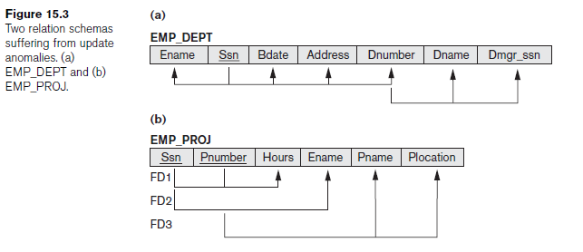
Guideline 1 violation
Chapter 10-<number>

Slide 9
1.2 Redundant Information in Tuples and Update Anomalies
Mixing attributes of multiple entities may cause problems
Information is stored redundantly wasting storage
Problems with update anomalies
  Insertion anomalies
  Deletion anomalies
  Modification anomalies
Chapter 10-<number>

Slide 10
EXAMPLE OF AN UPDATE ANOMALY (1)
Consider the relation:
EMP_PROJ ( Emp#, Proj#, Ename, Pname, No_hours)
Update Anomaly: Changing the name of project number P1 from “Billing” to “Customer-Accounting” may cause this update to be made for all 100 employees working on project P1.
Chapter 10-<number>

Slide 11
EXAMPLE OF AN UPDATE ANOMALY (2)
Insert Anomaly: Cannot insert a project unless an employee is assigned to .
Inversely - Cannot insert an employee unless an he/she is assigned to a project.
Delete Anomaly: When a project is deleted, it will result in deleting all the employees who work only on that project. Alternately, if an employee is the sole employee on a project, deleting that employee would result in deleting the corresponding project.
Chapter 10-<number>

Slide 12
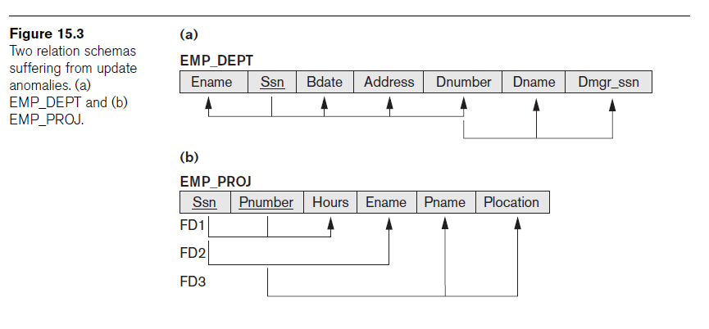
Figure 15.3 Two relation schemas suffering from update anomalies

Slide 13
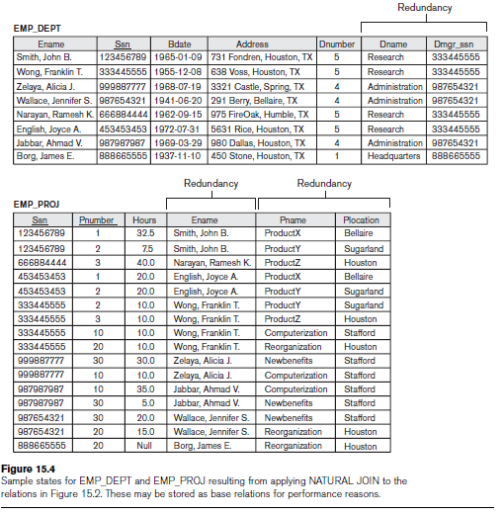
Figure 15.4 Example States for EMP_DEPT and EMP_PROJ

Slide 14
Guideline to Redundant Information in Tuples and Update Anomalies
GUIDELINE 2: Design a schema that does not suffer from the insertion, deletion and update anomalies. If there are any present, then note them so that applications can be made to take them into account

Slide 15
1.3 Null Values in Tuples
GUIDELINE 3: Relations should be designed such that their tuples will have as few NULL values as possible (wastage of space in storage level and difficulties in JOIN operation)
Attributes that are NULL frequently could be placed in separate relations (with the primary key)
Reasons for nulls:
  attribute not applicable or invalid
  attribute value unknown (may exist)
  value known to exist, but unavailable

Slide 16
1.4 Spurious Tuples
Bad designs for a relational database may result in erroneous results for certain JOIN operations
The "lossless join" property is used to guarantee meaningful results for join operations
GUIDELINE 4: The relations should be designed to satisfy the lossless join condition. No spurious tuples should be generated by doing a natural-join of any relations.
Chapter 10-<number>

Slide 17
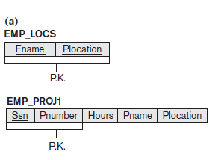
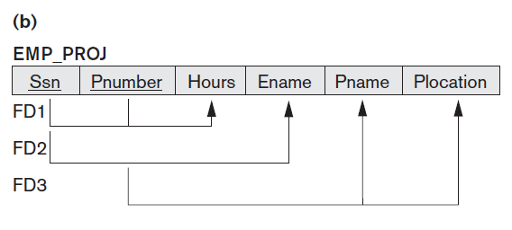
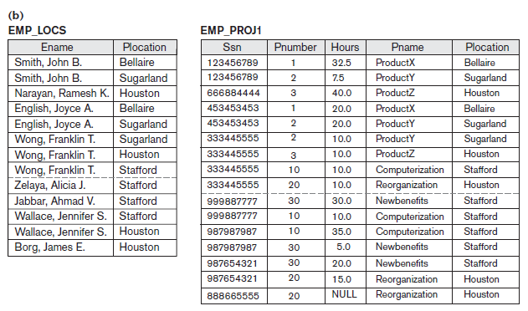
Chapter 10-<number>

Slide 18
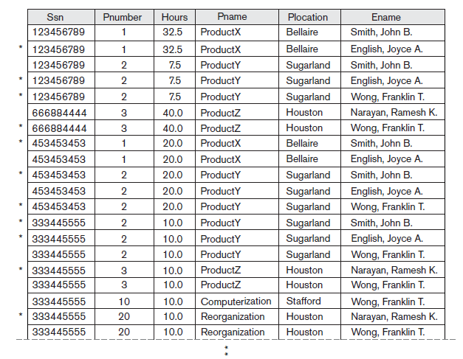
Chapter 10-<number>

Slide 19
1.4 Spurious Tuples ..
Design relation schemas so that they can be joined with equality conditions on attributes that are appropriately related (primary key, foreign key) pairs in a way that guarantees that no spurious tuples are generated. Avoid relations that contain matching attributes that are not (foreign key, primary key) combinations because
joining on such attributes may produce spurious tuples.
Chapter 10-<number>

Slide 20
Spurious Tuples (2)
There are two important properties of decompositions:
non-additive or losslessness of the corresponding join
preservation of the functional dependencies.
Note that property (a) is extremely important and cannot be sacrificed. Property (b) is less stringent and may be sacrificed. (See Chapter 16).

Slide 21
FUNCTIONAL DEPENDENCIES
Chapter 10-<number>

Slide 22
2.1 Functional Dependencies (1)
Functional dependencies (FDs) are used to specify formal measures of the "goodness" of relational schema designs
FDs and keys are used to define normal forms for relations
FDs are constraints that are derived from the meaning and interrelationships of the data attributes
A set of attributes X functionally determines a set of attributes Y if the value of X determines a unique value for Y
Chapter 10-<number>

Slide 23
Functional Dependencies (2)
X -> Y holds if whenever two tuples have the same value for X, they must have the same value for Y
For any two tuples t1 and t2 in any relation instance r(R): If t1[X]=t2[X], then t1[Y]=t2[Y]
X -> Y in R specifies a constraint on all relation instances r(R)
Written as X -> Y; can be displayed graphically on a relation schema as in Figures. ( denoted by the arrow: ).
FDs are derived from the real-world constraints on the attributes

Slide 24
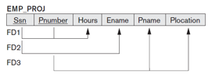
Examples of FD constraints (1)
social security number determines employee name
SSN -> ENAME
project number determines project name and location
PNUMBER -> {PNAME, PLOCATION}
employee ssn and project number determines the hours per week that the employee works on the project
{SSN, PNUMBER} -> HOURS
Chapter 10-<number>

Slide 25
Examples of FD constraints (2)
An FD is a property of the attributes in the schema R, not of a particular relation state
The constraint must hold on every relation instance r(R)
If K is a key of R, then K functionally determines all attributes in R (since we never have two distinct tuples with t1[K]=t2[K])
Chapter 10-<number>

Slide 26
2.2 Inference Rules for FDs (1)
Given a set of FDs F, we can infer additional FDs that hold whenever the FDs in F hold
Armstrong's inference rules:
IR1. (Reflexive) If Y subset-of X, then X -> Y
IR2. (Augmentation) If X -> Y, then XZ -> YZ
(Notation: XZ stands for X U Z)
IR3. (Transitive) If X -> Y and Y -> Z, then X -> Z
IR1, IR2, IR3 form a sound and complete set of inference rules
Chapter 10-<number>

Slide 27
Inference Rules for FDs (2)
Some additional inference rules that are useful:
(Decomposition) If X -> YZ, then X -> Y and X -> Z
(Union) If X -> Y and X -> Z, then X -> YZ
(Psuedotransitivity) If X -> Y and WY -> Z, then WX -> Z
The last three inference rules, as well as any other inference rules, can be deduced from IR1, IR2, and IR3 (completeness property)
Chapter 10-<number>

Slide 28
Inference Rules for FDs (3)
Closure of a set F of FDs is the set F⁺ of all FDs that can be inferred from F
Closure of a set of attributes X with respect to F is the set X ⁺ of all attributes that are functionally determined by X
X ⁺ can be calculated by repeatedly applying IR1, IR2, IR3 using the FDs in F
Chapter 10-<number>

Slide 29
2.3 Equivalence of Sets of FDs
Two sets of FDs F and G are equivalent if:
- every FD in F can be inferred from G, and
- every FD in G can be inferred from F
Hence, F and G are equivalent if F ⁺ =G ⁺
Definition: F covers G if every FD in G can be inferred from F (i.e., if G ⁺ subset-of F ⁺)
F and G are equivalent if F covers G and G covers F
There is an algorithm for checking equivalence of sets of FDs
Chapter 10-<number>

Slide 30
2.4 Minimal Sets of FDs (1)
A set of FDs is minimal if it satisfies the following conditions:
Every dependency in F has a single attribute for its RHS.
We cannot remove any dependency from F and have a set of dependencies that is equivalent to F.
We cannot replace any dependency X -> A in F with a dependency Y -> A, where Y proper-subset-of X ( Y subset-of X) and still have a set of dependencies that is equivalent to F.
Chapter 10-<number>

Slide 31
Minimal Sets of FDs (2)
Every set of FDs has an equivalent minimal set
There can be several equivalent minimal sets
There is no simple algorithm for computing a minimal set of FDs that is equivalent to a set F of FDs
To synthesize a set of relations, we assume that we start with a set of dependencies that is a minimal set (e.g., see algorithms 11.2 and 11.4)
Chapter 10-<number>

Slide 32
3 Normal Forms Based on Primary Keys
3.1 Normalization of Relations
3.2 Practical Use of Normal Forms
3.3 Definitions of Keys and Attributes Participating in Keys
3.4 First Normal Form
3.5 Second Normal Form
3.6 Third Normal Form
Chapter 10-<number>

Slide 33
Normal Forms Based on Primary Keys
Sequence of practical relational design projects
  conceptual schema design using a conceptual model - ER or EER, map the conceptual design into a set of relations
  Design the relations based on external knowledge derived from an existing implementation of files or forms or reports
  evaluate the relations for goodness and decompose them further as needed to achieve higher normal forms – Normalization

Slide 34
Normal Forms Based on Primary Keys
Normalization process - first proposed by Codd (1972), takes a relation schema through a series of tests to certify whether it satisfies a certain normal form.
The top-down process evaluates each relation against the criteria for normal forms and decomposing relations as necessary - relational design by analysis.
Codd proposed 3 normal forms - first, second, and third. A stronger definition of 3NF—called Boyce-Codd normal form (BCNF) - proposed by Boyce and Codd.
All these normal forms are based on a single analytical tool: the functional dependencies among the attributes of a relation.
Later, a fourth normal form (4NF) and a fifth normal form (5NF) were proposed, based on the concepts of multivalued dependencies and join dependencies

Slide 35
3.1 Normalization of Relations (1)
Normalization: The process of decomposing unsatisfactory "bad" relations by breaking up their attributes into smaller relations
Normal form: Condition using keys and FDs of a relation to certify whether a relation schema is in a particular normal form
Chapter 10-<number>

Slide 36
Normalization of Relations (2)
2NF, 3NF, BCNF based on keys and FDs of a relation schema
4NF based on keys, multi-valued dependencies : MVDs; 5NF based on keys, join dependencies : JDs (Chapter 16)
Additional properties may be needed to ensure a good relational design (lossless join, dependency preservation; Chapter 16)
Chapter 10-<number>

Slide 37
3.2 Practical Use of Normal Forms
Normalization is carried out in practice so that the resulting designs are of high quality and meet the desirable properties
The practical utility of these normal forms becomes questionable when the constraints on which they are based are hard to understand or to detect
The database designers need not normalize to the highest possible normal form. (usually up to 3NF, BCNF or 4NF)
Denormalization: the process of storing the join of higher normal form relations as a base relation—which is in a lower normal form
Chapter 10-<number>

Slide 38
3.3 Definitions of Keys and Attributes Participating in Keys (1)
A superkey of a relation schema R = {A₁, A₂, ...., A_{n}} is a set of attributes S subset-of R with the property that no two tuples t₁ and t₂ in any legal relation state r of R will have t₁[S] = t₂[S]
A key K is a superkey with the additional property that removal of any attribute from K will cause K not to be a superkey any more.
Chapter 10-<number>

Slide 39
Definitions of Keys and Attributes Participating in Keys (2)
If a relation schema has more than one key, each is called a candidate key. One of the candidate keys is arbitrarily designated to be the primary key, and the others are called secondary keys.
A Prime attribute must be a member of some candidate key
A Nonprime attribute is not a prime attribute—that is, it is not a member of any candidate key.
Chapter 10-<number>

Slide 40
3.2 First Normal Form (1NF)
Disallows composite attributes, multivalued attributes, and nested relations; attributes whose values for an individual tuple are non-atomic
Considered to be part of the definition of relation
Chapter 10-<number>

Slide 41
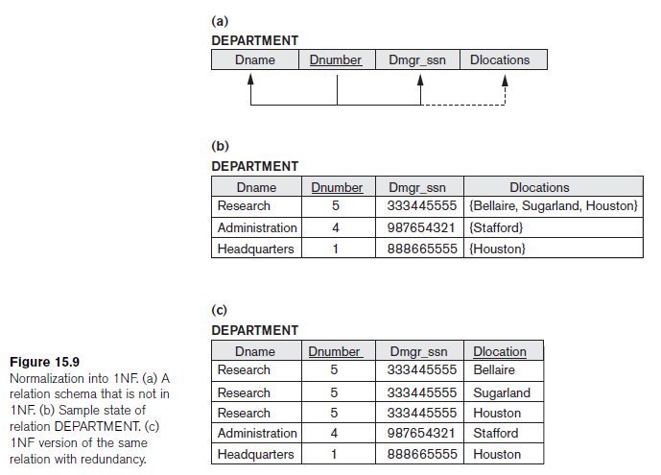
Figure 15.9 Normalization into 1NF

Slide 42
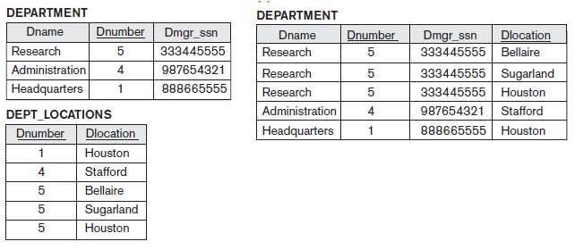
First Normal Form (1NF)
Remove the attribute Dlocations that violates 1NF and place it in a separate relation DEPT_LOCATIONS with the primary key {Dnumber, Dlocation}, DEPT_LOCATIONS exists for each location of a department. This decomposes the non-1NF relation into two 1NF relations.
Expand the key to have Dlocation in original DEPARTMENT relation. The primary key - {Dnumber, Dlocation}. This solution introduces redundancy.
If a max number of values for multi-valued attribute is known (3 in this case) - replace the Dlocations attribute by three atomic attributes: Dlocation1, Dlocation2, and Dlocation3. Disadvantage – too many NULL values, spurious semantics about the ordering among the location values, Querying on this attribute becomes more difficult.

Slide 43


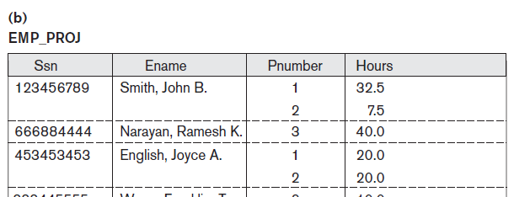

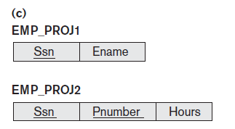

Fig 15.10 Normalization nested relations into 1NF

Slide 44
3.3 Second Normal Form (1)
Uses the concepts of FDs, primary key
Definitions:
Prime attribute - attribute that is member of the primary key K
Full functional dependency - a FD Y -> Z where removal of any attribute from Y means the FD does not hold any more
Examples: - {SSN, PNUMBER} -> HOURS is a full FD since neither SSN -> HOURS nor PNUMBER -> HOURS hold
- {SSN, PNUMBER} -> ENAME is not a full FD (it is called a partial dependency ) since SSN -> ENAME also holds
Chapter 10-<number>

Slide 45
Second Normal Form (2)
A relation schema R is in second normal form (2NF) if every non-prime attribute A in R is fully functionally dependent on the primary key
R can be decomposed into 2NF relations via the process of 2NF normalization
Chapter 10-<number>

Slide 46
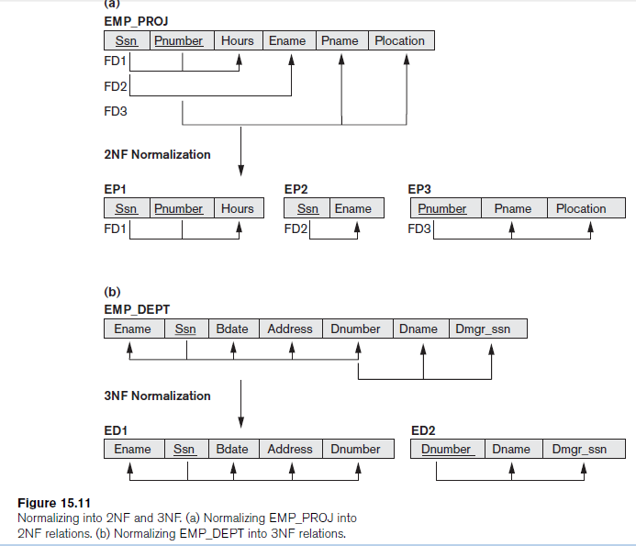
Figure 15.11 Normalizing into 2NF and 3NF
1. Ename violates 2NF because of FD2,
2. Pname and Plocation because of FD3 also violates 2NF.
The relation schema can be second normalized or 2NF normalized
into a number of 2NF relations. FD1, FD2, and FD3 lead to the decomposition of EMP_PROJ into the three relation schemas EP1, EP2, and EP3, each of which is in 2NF.

Slide 47
3.4 Third Normal Form (1)
Definition:
Transitive functional dependency - a FD X -> Z that can be derived from two FDs X -> Y and Y -> Z
Examples:
- SSN -> DMGRSSN is a transitive FD since
SSN -> DNUMBER and DNUMBER -> DMGRSSN hold
- SSN -> ENAME is non-transitive since there is no set of attributes X where SSN -> X and X -> ENAME
Chapter 10-<number>

Slide 48
Third Normal Form (2)
A relation schema R is in third normal form (3NF) if it is in 2NF and no non-prime attribute A in R is transitively dependent on the primary key
R can be decomposed into 3NF relations via the process of 3NF normalization
NOTE:
In X -> Y and Y -> Z, with X as the primary key, we consider this a problem only if Y is not a candidate key. When Y is a candidate key, there is no problem with the transitive dependency .
E.g., Consider EMP (SSN, Emp#, Salary ).
Here, SSN -> Emp# -> Salary and Emp# is a candidate key.
Chapter 10-<number>

Slide 49
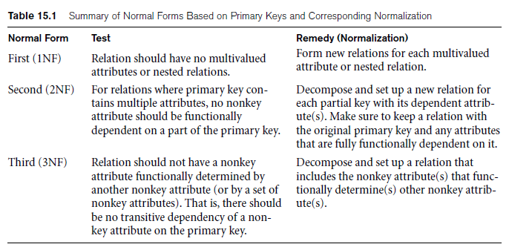
General Definitions of Second and Third Normal Forms

Slide 50
4 General Normal Form Definitions (For Multiple Keys) (1)
The above definitions consider the primary key only
The following more general definitions take into account relations with multiple candidate keys
A relation schema R is in second normal form (2NF) if every non-prime attribute A in R is fully functionally dependent on every key of R
Chapter 10-<number>

Slide 51
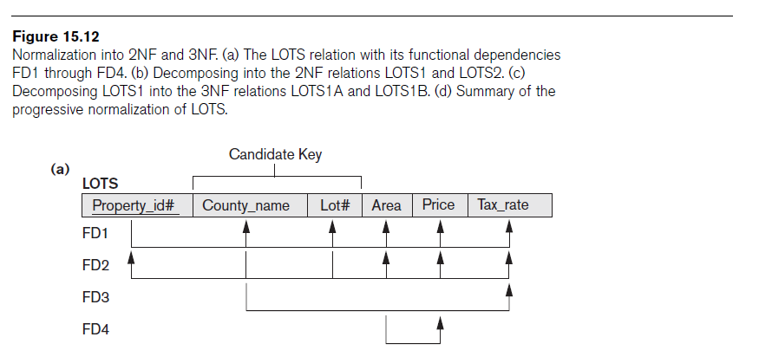
General Definition of 2NF
violates the general definition of 2NF because Tax_rate is partially dependent on the candidate key {County_name, Lot#},

Slide 52
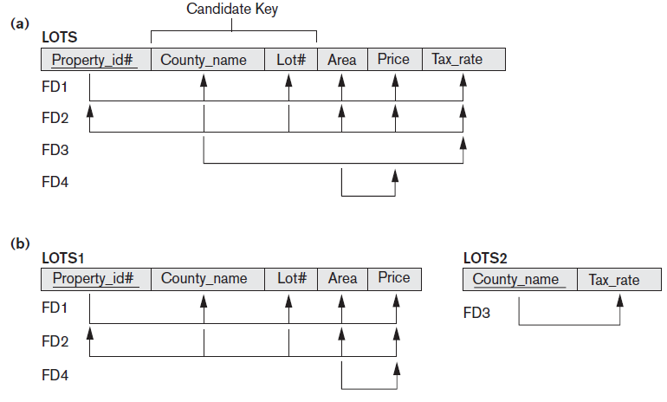
General Definition of 2NF

Slide 53
General Normal Form Definitions (2)
Definition:
Superkey of relation schema R - a set of attributes S of R that contains a key of R
A relation schema R is in third normal form (3NF) if whenever a FD X -> A holds in R, then either:
(a) X is a superkey of R, or
(b) A is a prime attribute of R
NOTE: Boyce-Codd normal form disallows condition (b) above
Chapter 10-<number>

Slide 54
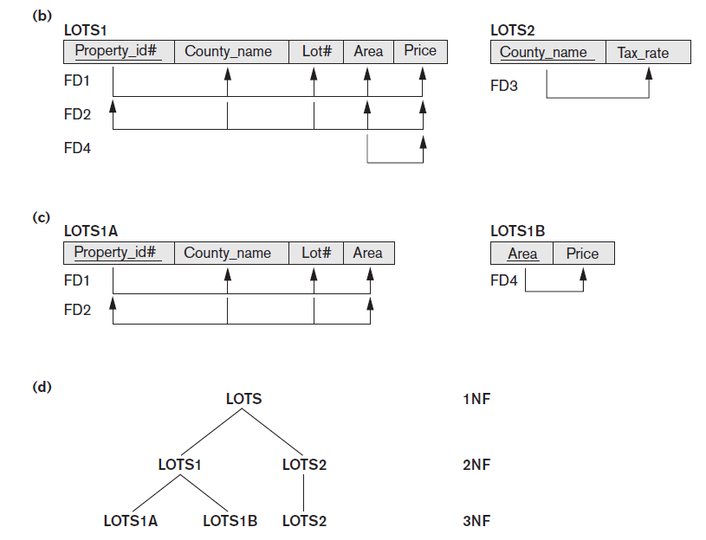

Slide 55
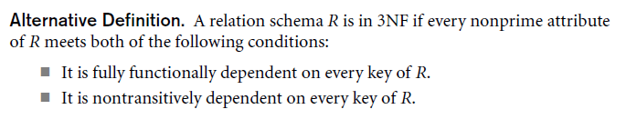
Chapter 10-<number>

Slide 56
5 BCNF (Boyce-Codd Normal Form)
A relation schema R is in Boyce-Codd Normal Form (BCNF) if whenever an FD X -> A holds in R, then X is a superkey of R
Each normal form is strictly stronger than the previous one
  Every 2NF relation is in 1NF
  Every 3NF relation is in 2NF
  Every BCNF relation is in 3NF
There exist relations that are in 3NF but not in BCNF
Most relation schemas that are in 3NF are also in BCNF
The goal is to have each relation in BCNF (or 3NF)
Chapter 10-<number>

Slide 57
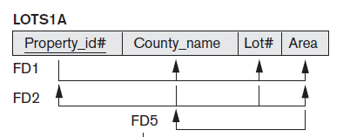
BCNF
Suppose that we have thousands of lots in the relation and lots are from only two counties: DeKalb and Fulton. Suppose also that lot sizes in DeKalb County are only 0.5 to 1.0 acres, whereas lot sizes in Fulton County are from 1.1 to 2.0 acres. This adds a functional dependency FD5: Area->County_name.
LOTS1A still is in 3NF because County_name is a prime attribute, but not in BCNF as Area is not a superkey of LOTS1A
Chapter 10-<number>

Slide 58
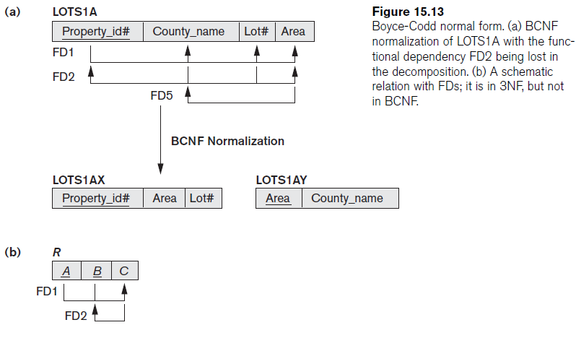
Figure 15.3 Boyce-Codd normal form

Slide 59
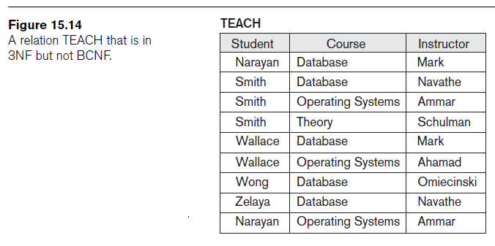

Figure 15.4 a relation TEACH that is in 3NF but not in BCNF

Slide 60
Achieving the BCNF by Decomposition (1)
Two FDs exist in the relation TEACH:
fd1: { student, course} -> instructor
fd2: instructor -> course
{student, course} is a candidate key for this relation and that the dependencies shown follow the pattern in Figure 10.12 (b). So this relation is in 3NF but not in BCNF
A relation NOT in BCNF should be decomposed so as to meet this property, while possibly forgoing the preservation of all functional dependencies in the decomposed relations. (See Algorithm 11.3)
Chapter 10-<number>

Slide 61
Achieving the BCNF by Decomposition (2)
Three possible decompositions for relation TEACH
  {student, instructor} and {student, course}
  {course, instructor } and {course, student}
  {instructor, course } and {instructor, student}
All three decompositions will lose fd1. We have to settle for sacrificing the functional dependency preservation. But we cannot sacrifice the non-additivity property after decomposition.
Out of the above three, only the 3rd decomposition will not generate spurious tuples after join.(and hence has the non-additivity property).
A test to determine whether a binary decomposition (decomposition into two relations) is nonadditive (lossless) is discussed in section 11.1.4 under Property LJ1. Verify that the third decomposition above meets the property.
Chapter 10-<number>

Slide 62
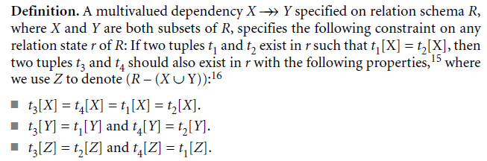
Multivalued Dependency and Fourth Normal Form
Multivalued dependency (MVD)
  Consequence of first normal form (1NF)

Slide 63

Multivalued Dependency and Fourth Normal Form (cont’d.)
Relations containing nontrivial MVDs
  All-key relations
Fourth normal form (4NF)
  Violated when a relation has undesirable multivalued dependencies

Slide 64
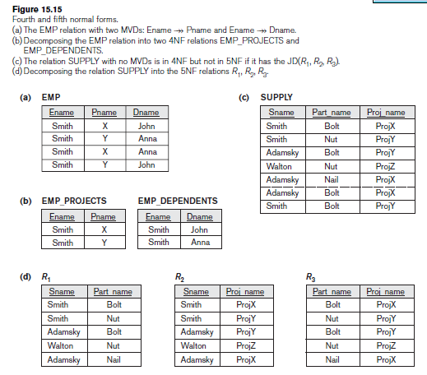
Multivalued Dependency and Fourth Normal Form (cont’d.)
Chapter 10-<number>

Slide 65
Join Dependencies and Fifth Normal Form
Join dependency
Multiway decomposition into fifth normal form (5NF)
Very peculiar semantic constraint
  Normalization into 5NF is very rarely done in practice

Slide 66
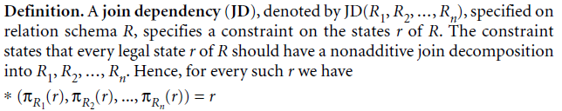
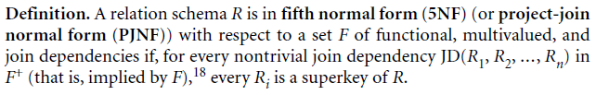
Join Dependencies and Fifth Normal Form (cont’d.)

Slide 67
Summary
Informal guidelines for good design
Functional dependency
  Basic tool for analyzing relational schemas
Normalization:
  1NF, 2NF, 3NF, BCNF, 4NF, 5NF

